Slide 1



The Three vs Defensive
Kirsten Gramajo

Slide 2
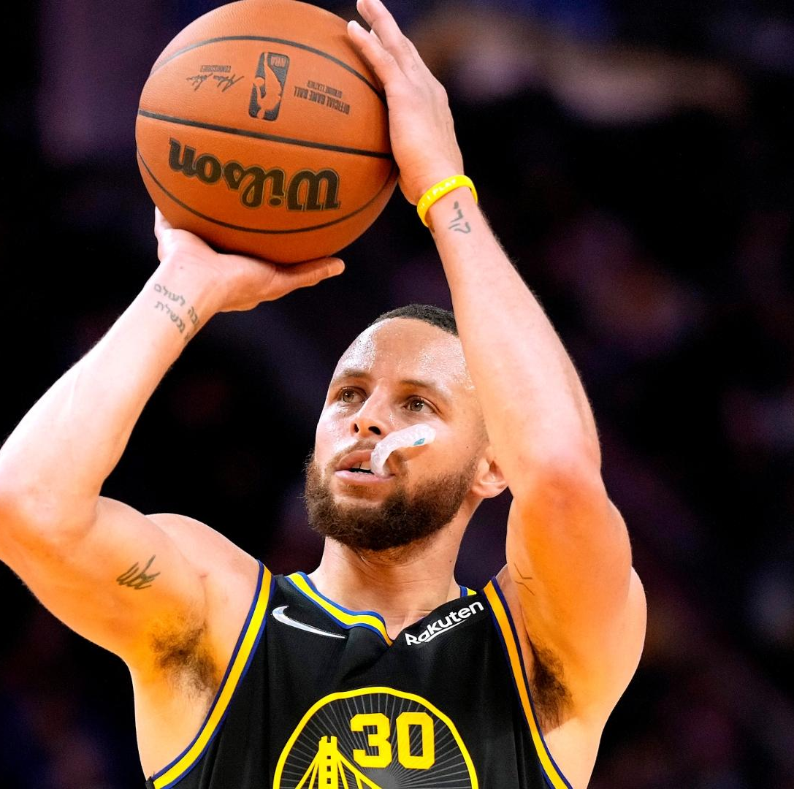
The Three-Point Revolution
Two vs Three Point field goal
Starting in the mid-2010s
Steph Curry and the Golden State Warriors

Slide 3
Research Question
How has the three-point shot impacted a team’s defensive metrics?
Has there been an increase in the number of Blocks, Defensive Rebounds, and Steals performed by a team due to the increased number of three-point shots being attempted and allowed?

Slide 4

Data
Basketball Reference
Team Per Game Stats (PG)
Opponent Per Game Stats (OPG)
Advanced Stats (ADV)
15 National Basketball Association (NBA) Seasons
Start: 2009 – 2010 NBA Season [Data: 2010 Season]
Final: 2023 -2024 NBA Season [Data: 2024 Season]

Slide 5

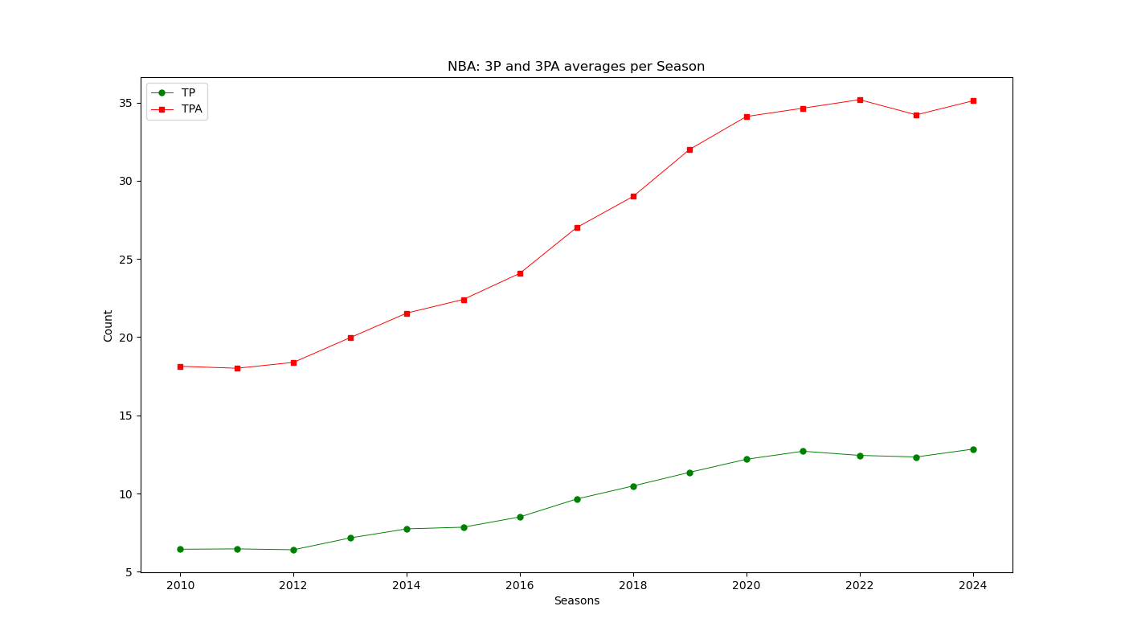
Evolution of the Three

Slide 6
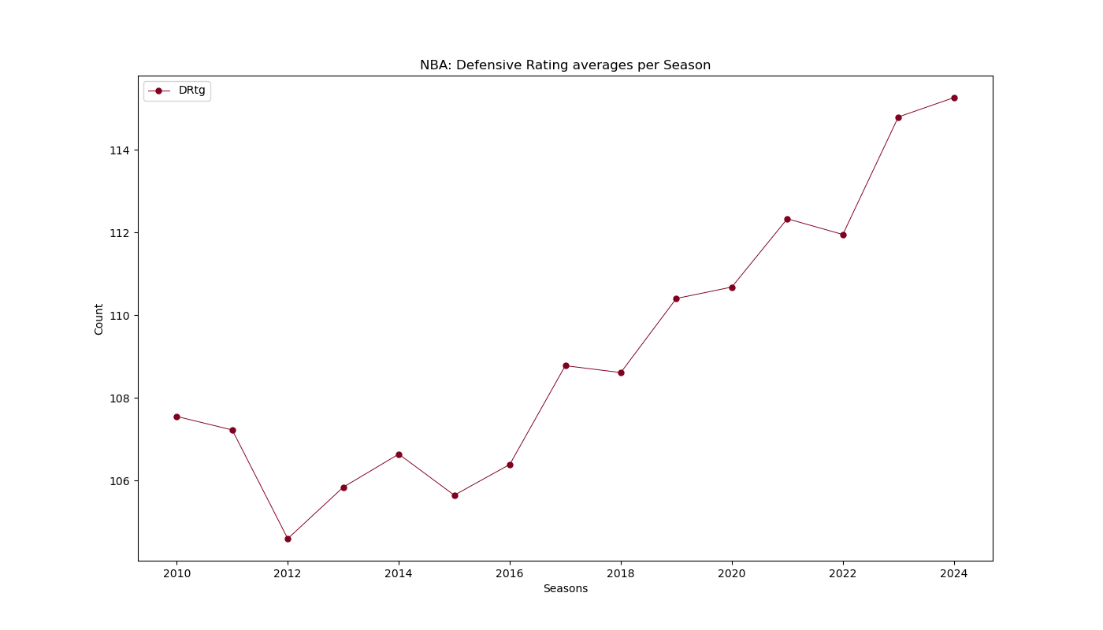
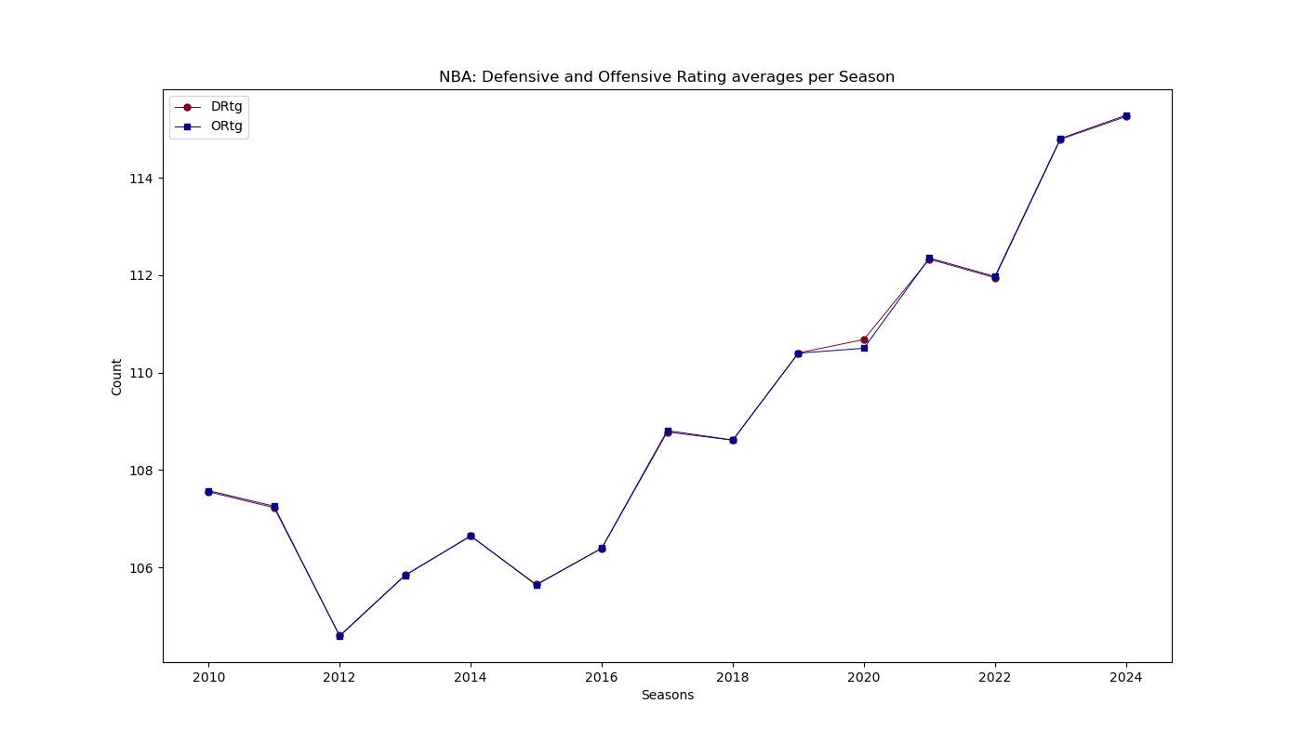
Defensive vs Offensive Rating

Slide 7
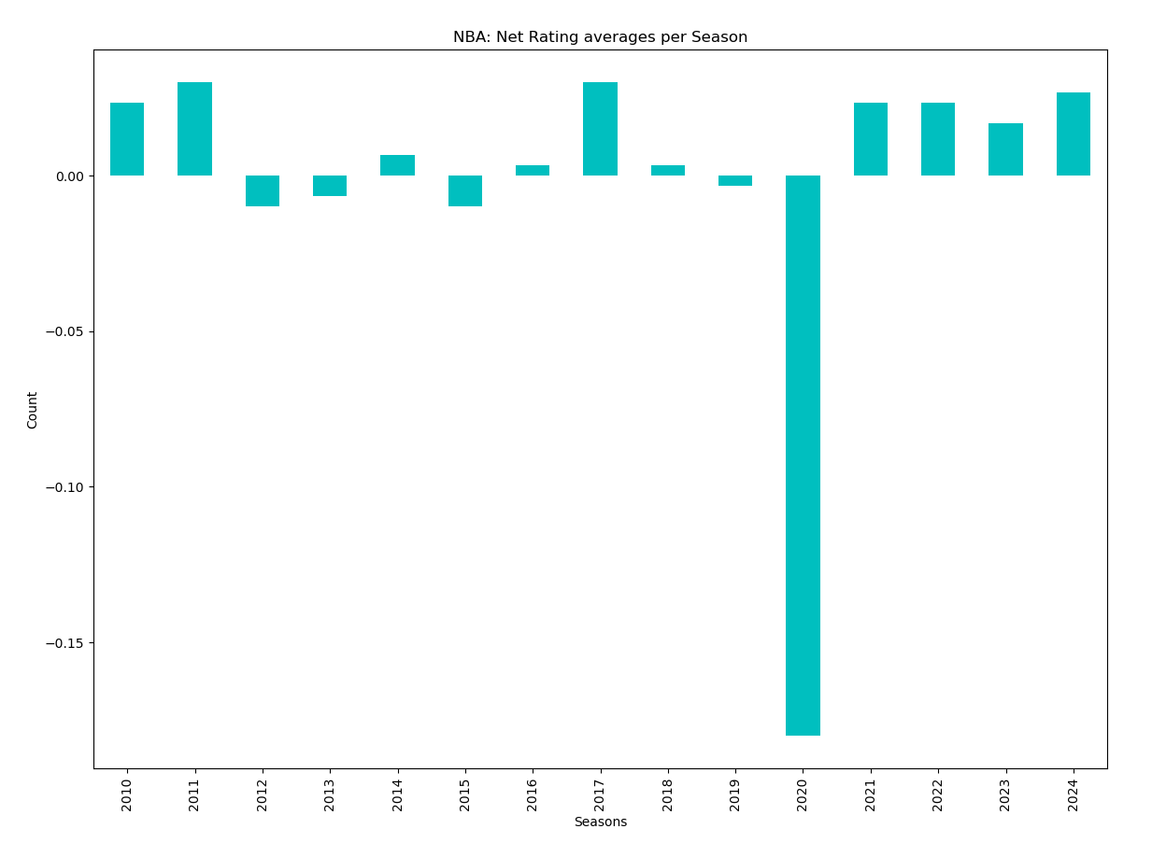

Slide 8
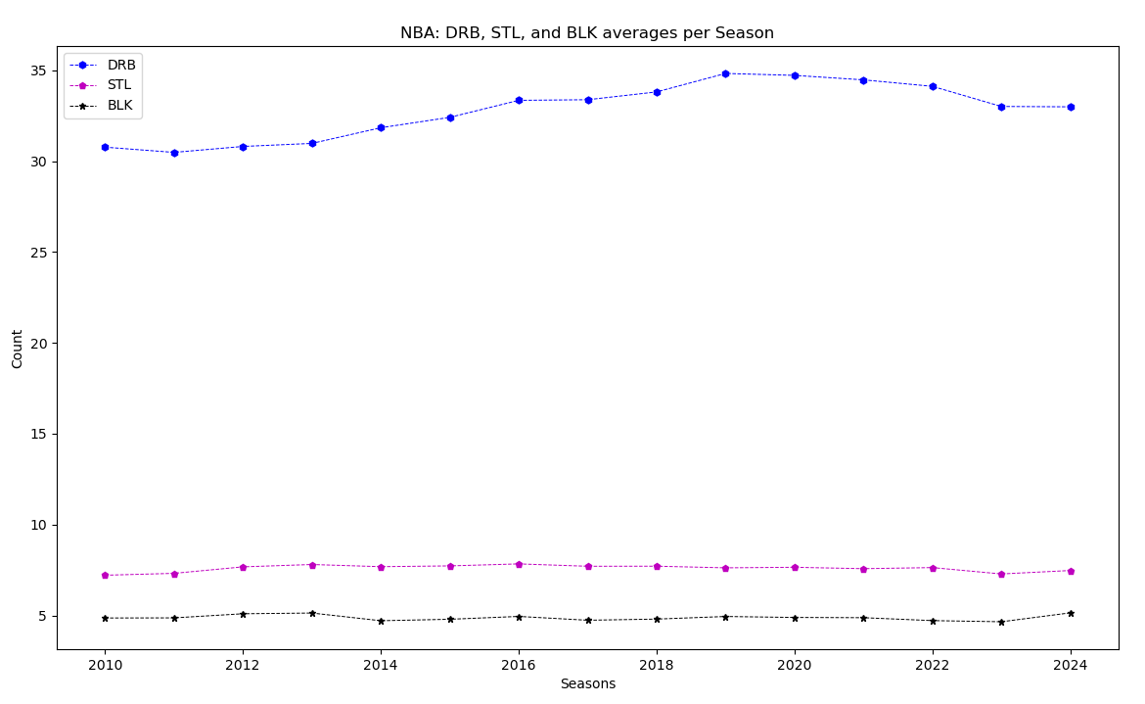
Evolution of BLK, STL, and DRB

Slide 9
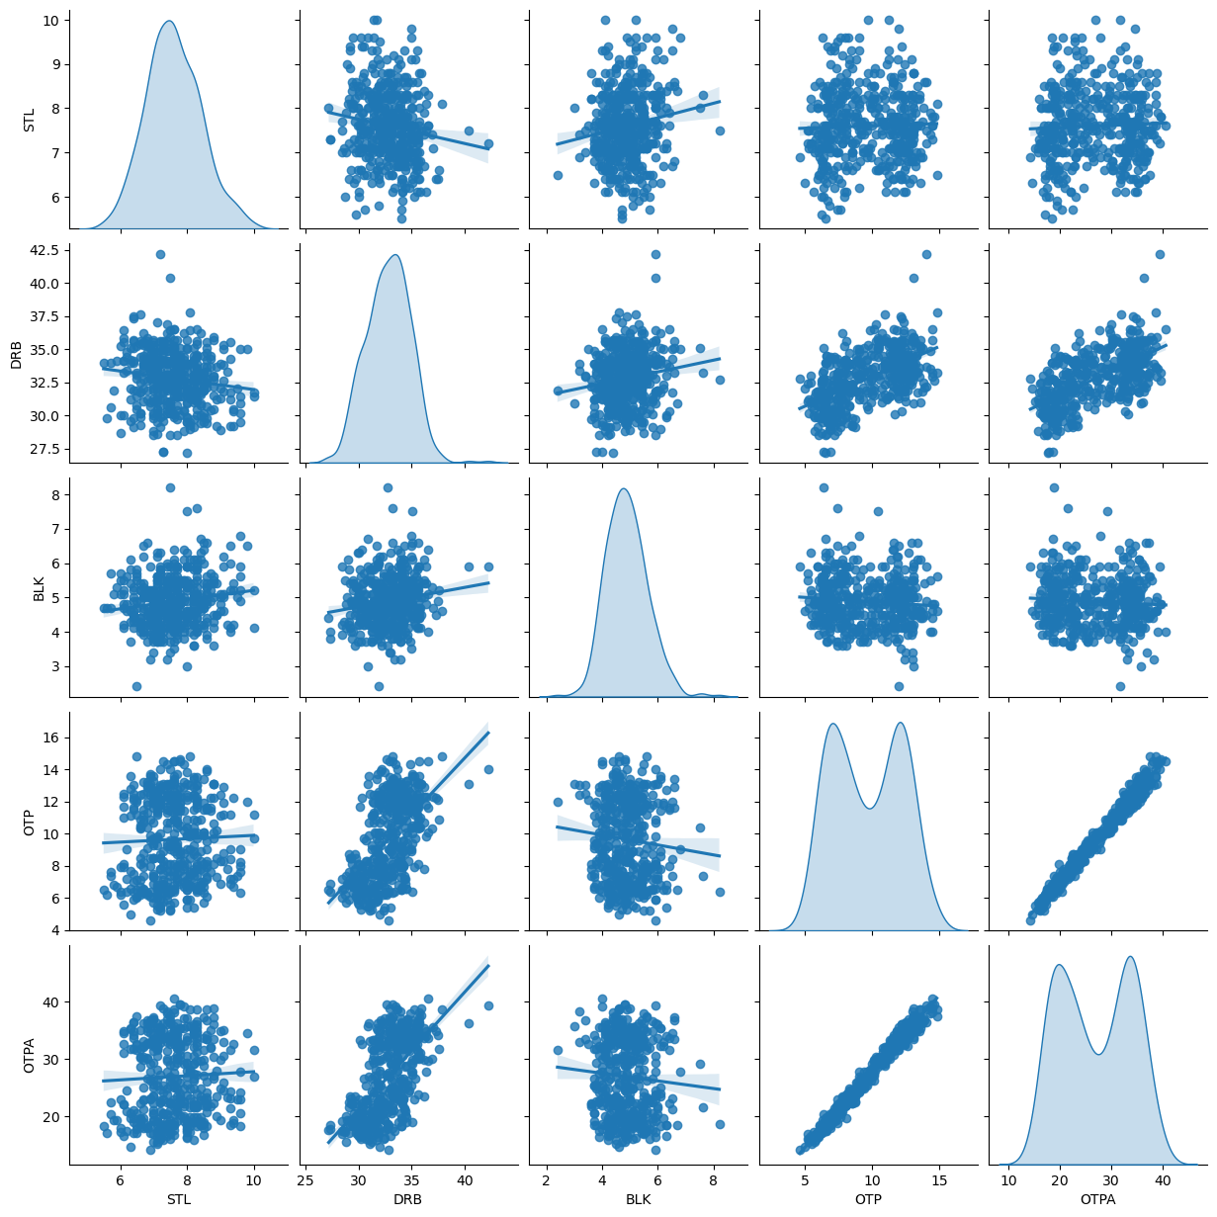
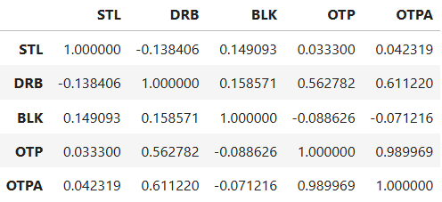

Slide 10
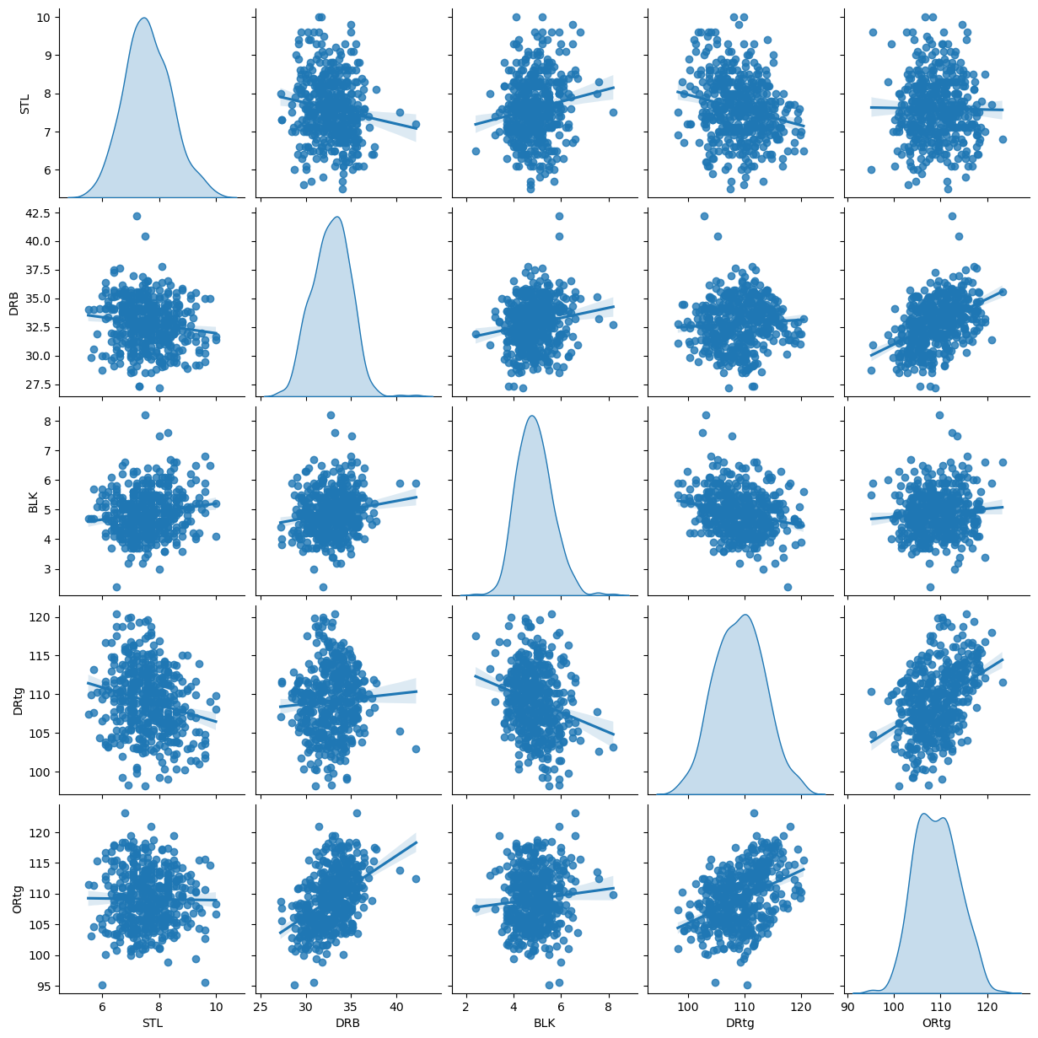
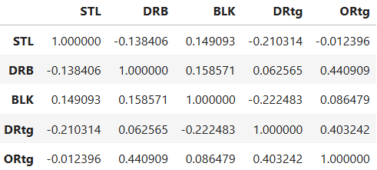

Slide 11
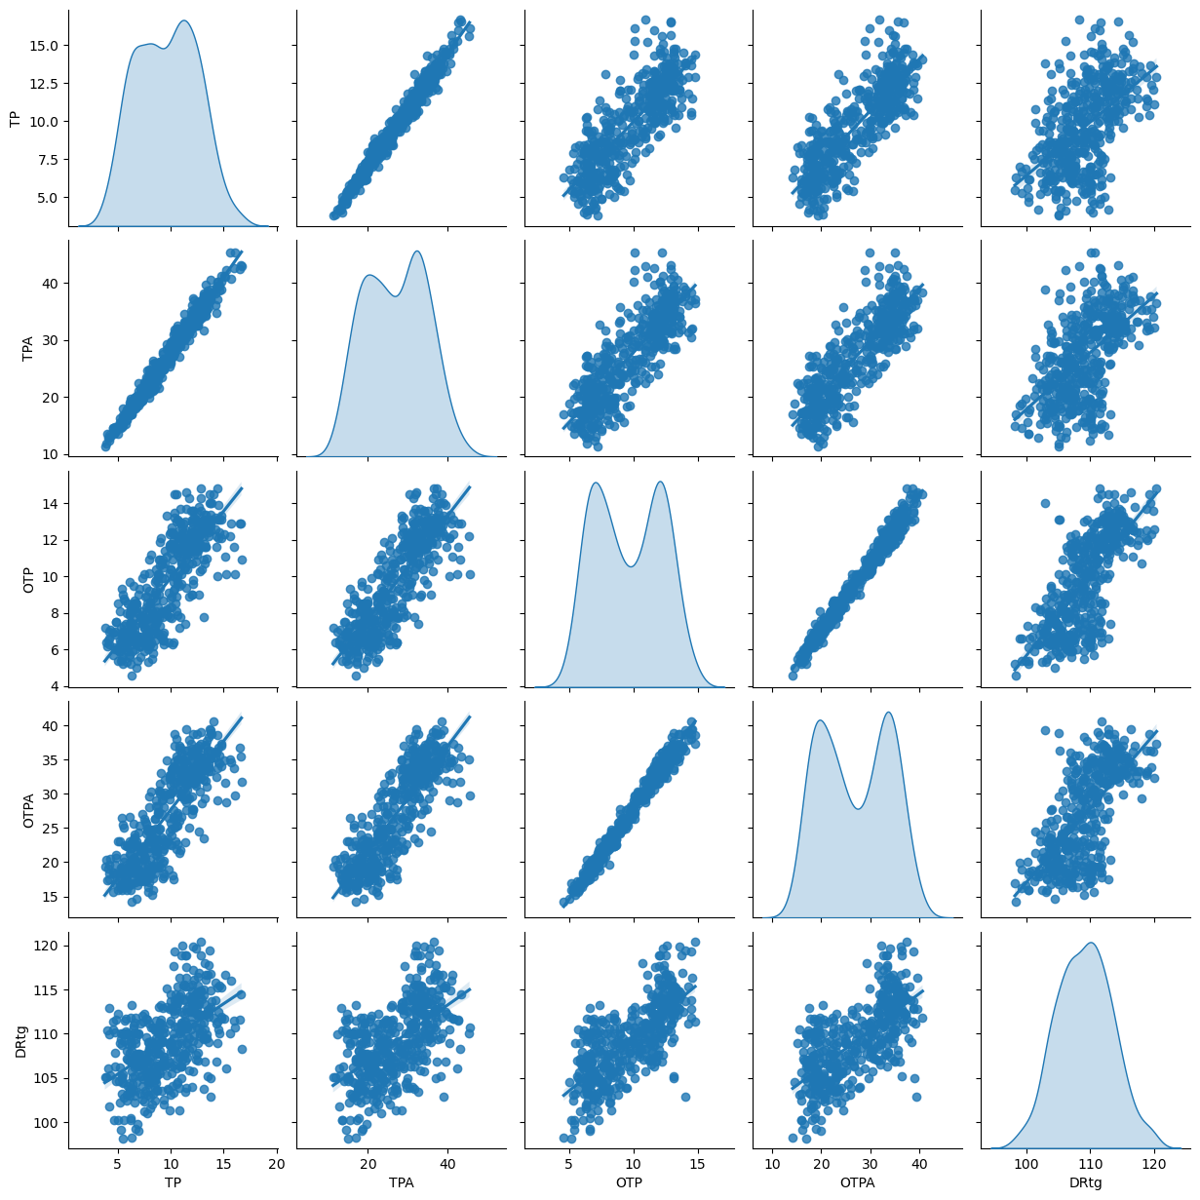
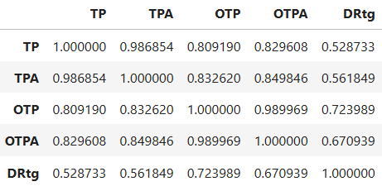

Slide 12

Correlation

Slide 13
Conclusion
There has been no increases to the number of Blocks and Steals performed to better prevent three points attempted/allowed however there is slight increase to the number of Defensive Rebounds being done

